Slide 1
Cyclist Annual Memberships
How do Member and Casual Riders Compare?

Slide 2

Business Task
Cyclistic’s finance analysts have determined that annual memberships are more profitable than casual riders
Therefore we’d like to convert casual riders into subscription rides
So how to subscribed members compare to casual members?
Are there any casual members we could convert to subscribed members based on their habits?

Slide 3

Description of the Data Sources
Data comes from Q2-Q4 of 2019 and Q1 of 2020 from the company’s internal data
Between the Q4 and Q1 data sets, Cyclistic changed how it was storing user information, so data had to be processed to ensure proper merger of the data sets

Slide 4

Data Processing
Data was initially processed in R
R was used to standardize column headings, properly format data, and calculate ride times (in seconds)
This data was then exported as composite of the four quarters and loaded into Tableau
Tableau as then used to generate visualizations of the data and identify trends
Because 2020 Q1 data did not have customer IDs, it was not possible to uniquely identify customers and their ages, so age information had to be omitted

Slide 5
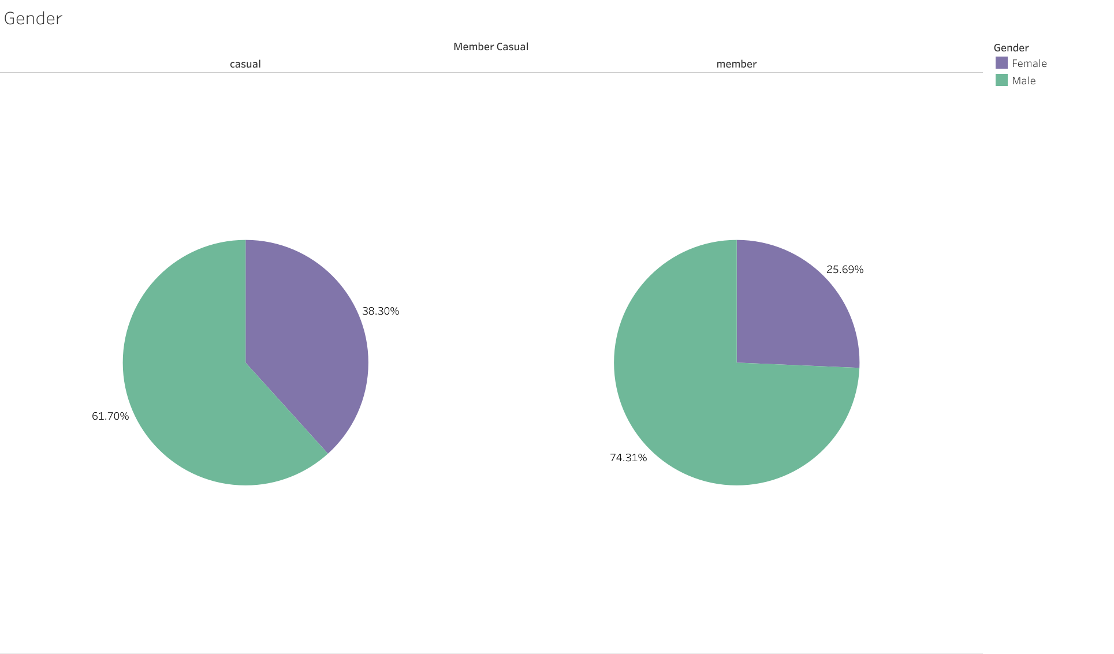
Summary – Gender
Based on riders who reported their gender, the membership of Cyclisic is predominately male
Whereas the casual membership, while majority male, is less male dominated

Slide 6
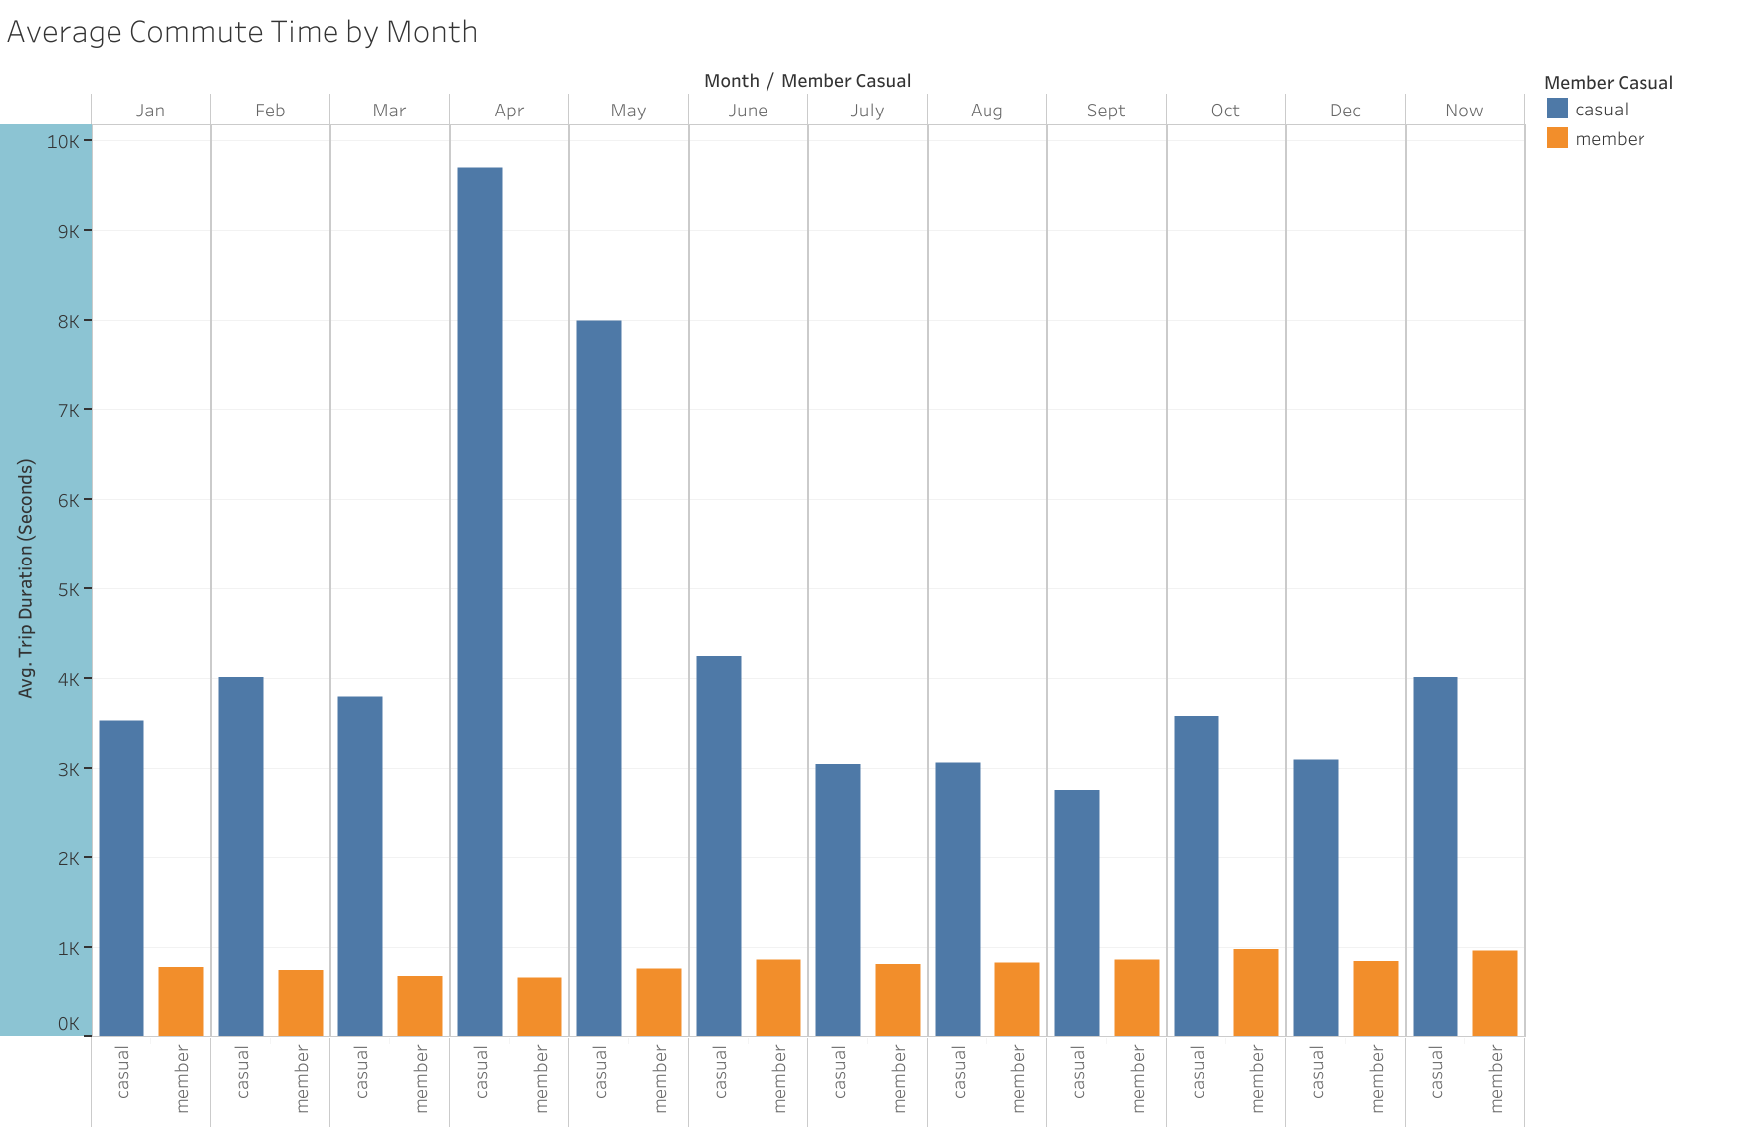
Summary – Commute Distances by Month
Based on time of year, the average commute time of casual users is higher than that of members
This average commute time also spikes in the April to May months, but stay steady throughout the rest of the year

Slide 7
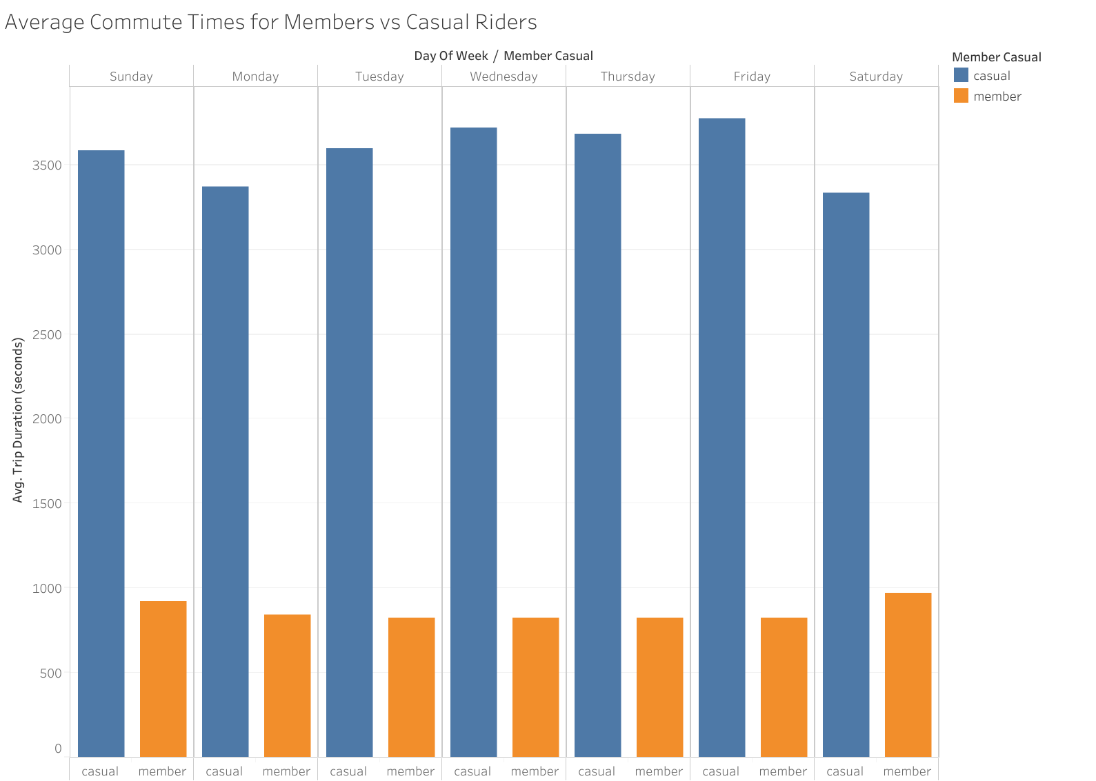
Summary – Commute Distances by Day of the Week
Similarly, the average commute time for casuals is much higher than that for members throughout the week

Slide 8
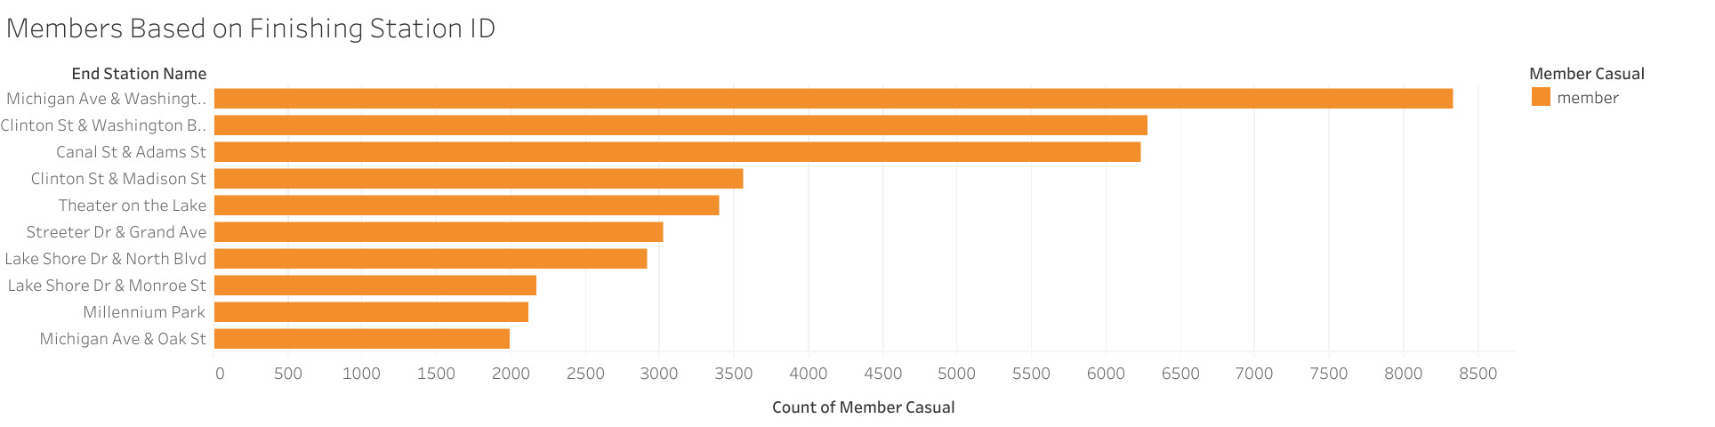
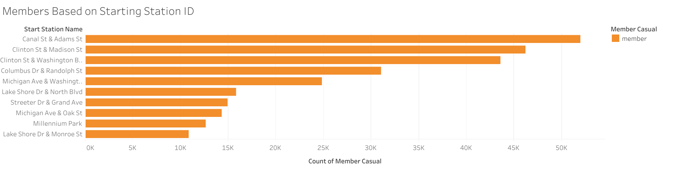
Summary – Starting and Finishing Members
If we look at starting verses finishing destinations, members tend to finish at a location different where they start for the most 10 most common centers

Slide 9
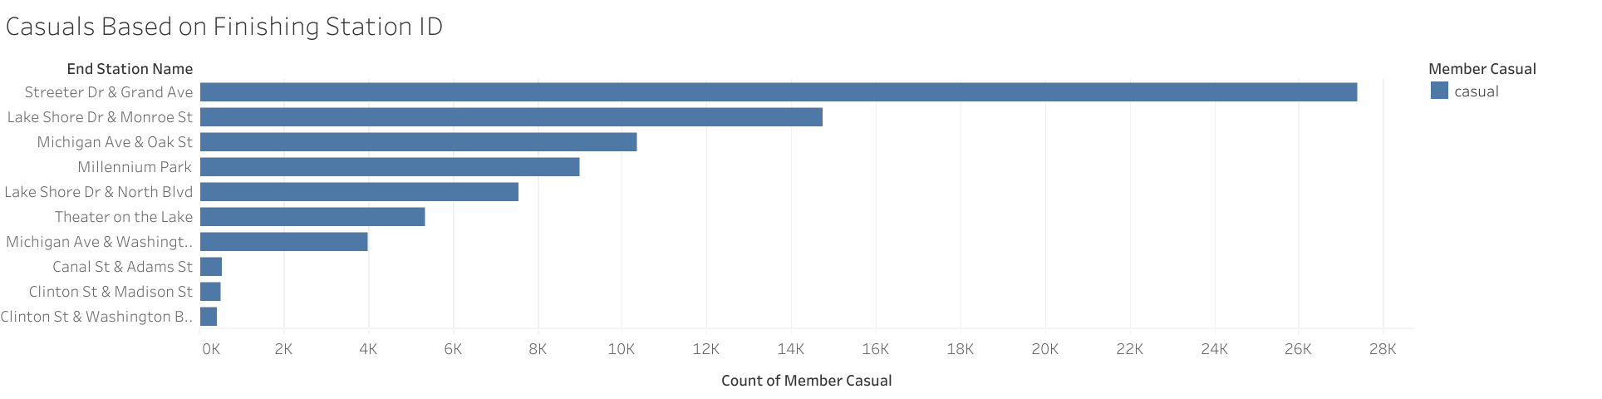
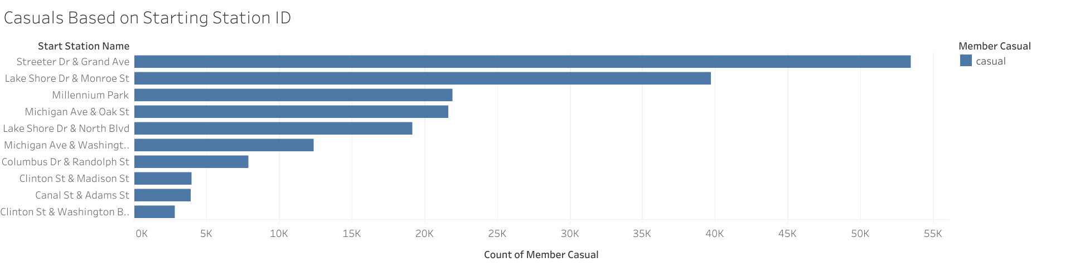
Summary – Starting and Finishing Casuals
This is in contrast to casual riders, who tend to finish at the same place they start
Casual riders appear to not being going to a destination, unlike members, but rather making a roundtrip on their ride

Slide 10
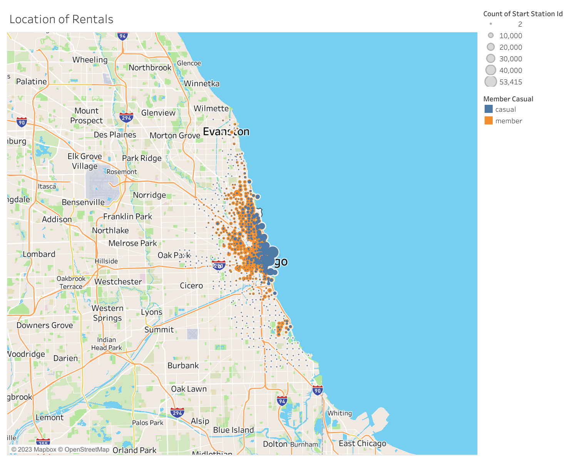
Summary – Geographical Areas
There appears to be two distinct regions of rentals
Most casual rentals are located near the Navy Pier and Grant Park
More member rentals are located within the city itself

Slide 11

Key Findings
Casuals tend to finish their rides where they start, whereas members tend to finish in a different place than they start
A majority of casual riders are in the Grant Park/Navy Peer location
Casual riders commute further than the average member

